Slide 1
Sample ML project
CS5224 Resource
2025-26 Sem 1
Timothy Antoni <timothy.antoni@u.nus.edu>
Notes:
Im timothy. In this video show you how make simple cloud computing ML project. The purpose of this video is to serve as a possible template for your CS5224 project as well as a basic guide on cloud computing practices. Lets get into it

Slide 2
The case
You have a model that can predict diabetes status (positive, negative, risked) based on age, gender, BMI, etc.
You want to make profit by charging hospitals when they use your model.
You would want to have the model on the cloud, setup a server that accepts client (hospital) data, and send back the prediction data to the client.
You want to do this in an automated, end-to-end fashion.
Notes:
In this project were gna build a model that can predict diabetes based on some features. We make pay-per-use pipeline for hospitals to assess the diabetes risk of their patients. For this, we setup a cloud server that takes in, process, and push data back to client all automatically.

Slide 3
The steps
Make pipeline diagram
Make scripts
Train ML model
Get an EC2 Instance Running
Upload scripts and ML model to EC2
Test the pipeline
Check accuracy of the results
Notes:
Divide the project into a few steps. Diagram good visualize big picture coordinate and understand btr among team. From vis can see what we want to perform, make scripts for the steps. Ml…

Slide 4
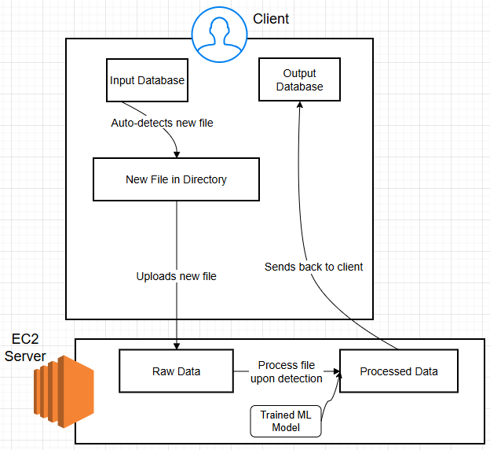
1. Make pipeline diagram
Use draw.io
Generate diagrams from prompt
Free AWS Icons
Notes:
I recommend draw.io cos free, can generate diagrams from prompt. This is the sample result. Explain more on our project diagram next slide

Slide 5
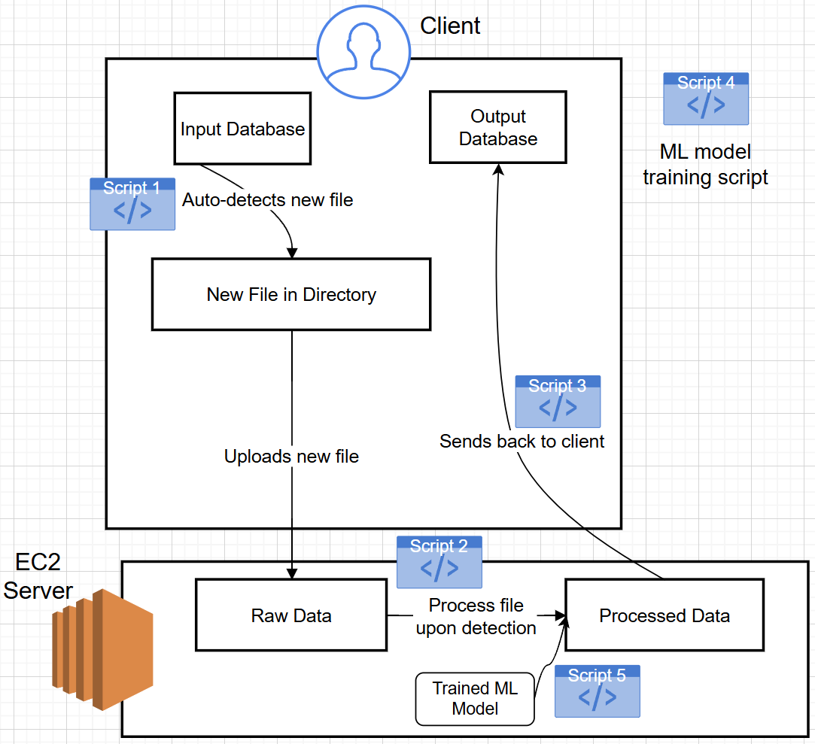
2. Make scripts
local_watch_and_upload.py
ec2_receive_and_process_file.py
local_receive_file.py
local_train.py
ec2_model_inference.py
Scripts are not uploaded!
Notes:
Lets dissect this diagram. We start in client’s input. We want to auto detect new file and upload it to our server. This is the function of script 1. <press> In the server, we want to auto detect incoming file, run our ML model on it, and push the result to the client. This will be done by script 2. <press> The third script handles output receival in client side. <press> Two extra scripts are needed for the ML model training and inference. Keep in mind that I wont upload the scripts to canvas because the purpose of this video is to serve as an inspiration for your own project and not tobe copypasted. With that in mind, lets now code these scripts.

Slide 6
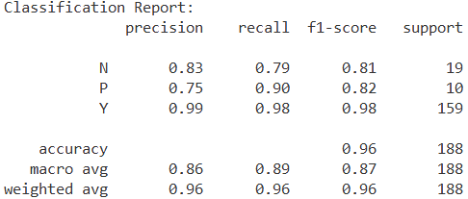
3. Train ML model
Download data from canvas under “Resources / Sample ML Project” folder
Training data: diabetes.csv
Unseen test data features: newTest[1-3]_features.csv
Unseen test data labels: newTest[1-3]_labels.csv
Model: model.joblib (if needed)
Run local_train.py
Performance metrics on internal test set
Dataset sourced from https://data.mendeley.com/datasets/wj9rwkp9c2/1

Slide 7
4. Get an EC2 Instance Running
Refer to Indrayani’s video for more information on how to create AWS account and run an EC2 Instance
Allow HTTP, HTTPS traffic for the EC2 Instance
Install python, pandas, joblib, scikit-learn, flask
Shell commands (available in Resource folder):
wget https://repo.anaconda.com/miniconda/Miniconda3-latest-Linux-x86_64.sh
bash Miniconda3-latest-Linux-x86_64.sh
conda install pandas joblib scikit-learn flask -y

Slide 8
5. Upload scripts and ML model to EC2
Shell commands (available in Resource folder):
scp -i /path/to/your-key-pair.pem /path/to/local/file ec2-user@<your-ec2-public-ipv4>:/home/ec2-user/

Slide 9
6. Test the pipeline
Try dropping one file.
Try dropping multiple files at the same time.

Slide 10
7. Check the accuracy of the results
How would you do this?

Slide 11

Thank you!
Any questions, email me at timothy.antoni@u.nus.edu

